Slide 1
MuscleHub
Analysis of membership purchases after fitness test
Author: Mariana Mytiliños
Last updated: March 19, 2022
Analyzing Data with Python Capstone Project - Codecademy

Slide 2
Table of Contents
Summary of the A/B test
Hypothesis test 1: Difference in applications between visitors (A/B)
Hypothesis test 2: Difference in purchases between applicants (A/B)
Hypothesis test 3: Difference in purchases between visitors (A/B)
Summary of interview data
Recommendations for MuscleHub
Appendix

Slide 3
A/B test

Slide 4
A/B test
Goal: Determine if the fitness test prior to the gym application intimidates prospective members.
Random assignment of visitors to one of two groups:
Group A was still asked to take a fitness test with a personal trainer
Group B skipped the fitness test and proceeded directly to the application

Slide 5
Null Hypothesis: There won’t be a significant difference between the visitors in Group A and Group B that purchase a membership.
Alternate Hypothesis: There will be significantly more visitors in Group B that purchase membership than visitors in Group A who do so.
The significance threshold set as the benchmark to either accept or fail to reject the null hypothesis is: p value = 0.05

Slide 6
A/B: Applications between visitors

Slide 7

Hypothesis test 1:
Difference in applications between visitors (A/B)
Null hypothesis is rejected *: There is a significant difference between the visitors in group A and group B that turned in an application.
Performed significance test in Python using the chi2_contingency function from scipy.stats
* p value = 0.00096 (< 0.05)

Slide 8
A/B: Purchases between applicants

Slide 9

Hypothesis test 2:
Difference in purchases between applicants (A/B)
Null hypothesis is accepted *: There isn’t a significant difference in the purchase of memberships between applicants in group A and group B
Performed significance test in Python using the chi2_contingency function from scipy.stats
* p value = 0.4325 (> 0.05)

Slide 10
A/B: Purchases between visitors

Slide 11

Hypothesis test 3:
Difference in purchases between visitors (A/B)
Null hypothesis is rejected *: There is a significant difference in the purchase of memberships between visitors in group A and group B.
Performed significance test in Python using the chi2_contingency function from scipy.stats
* p value = 0.0147 (> 0.05)

Slide 12
Summary of interviews

Slide 13
Summary of interviews
Key takeaways *:
Positive: Super helpful, motivating, the personal trainers’ approach was well-received, friendly people, quick sign-up process, felt welcome
Negative: Regretted taking the test, sweat stains on the weight machines
* based on 4 interviews regarding the introductory fitness test, conducted to MuscleHub visitors.

Slide 14
Recommendations

Slide 15
Recommendations
Based on the hypothesis tests and interviews conducted, we recommend to:
Remove the fitness test from the application process, in order to make the process quicker and less intimidating for prospective members.
Encourage the personal trainers’ to keep their friendly and motivating approach.

Slide 16
Appendix
Data visualization

Slide 17
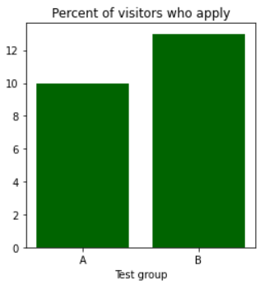
Percent of MuscleHub visitors who fill out an application for the gym.
Source: Self-elaboration (Python).

Slide 18
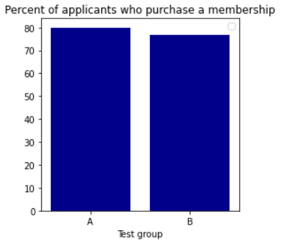
Percent of MuscleHub applicants who purchase a membership.
Source: Self-elaboration (Python).

Slide 19
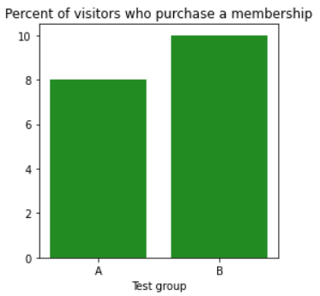
Percent of MuscleHub visitors who purchase a membership.
Source: Self-elaboration (Python).

Slide 20
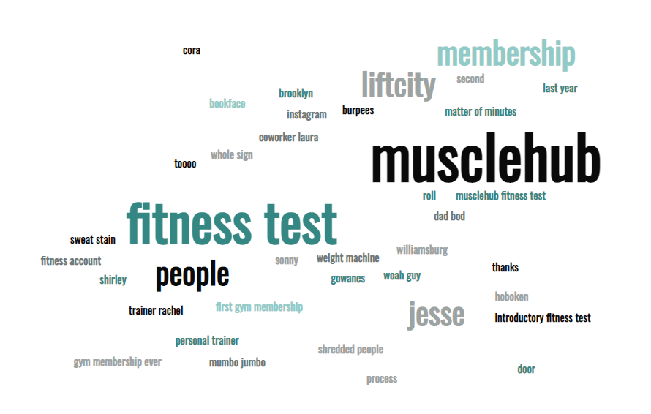
WordCloud created based on MuscleHub interviews.
Source: Self-elaboration (MonkeyLearn WordCloud Generator).

Slide 21
Thank you.

